Slide 1
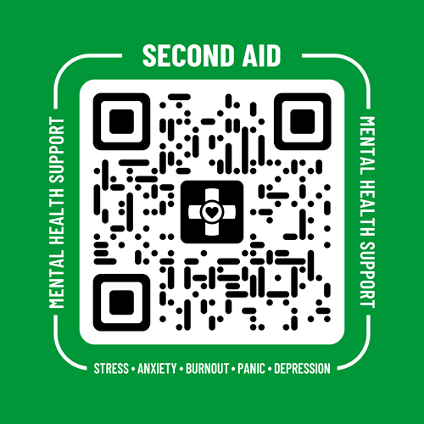

We have First Aid for physical health.
Meet Second Aid
for mental health.
Second Aid
secondaid.com

Slide 2

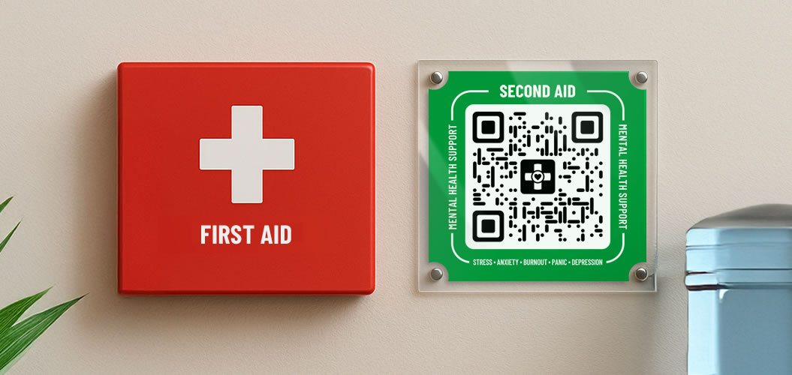
It’s simple.
What First Aid is for Physical Health, Second Aid is for Mental Health.
For detailed information,
visit secondaid.com/about
What is
Second Aid?

Slide 3


It’s a mirror image.
First Aid | Second Aid
Physical Health | Mental Health
Visible & accessible in emergencies | Visible & accessible in emergencies
Stops bleeding | Stops overload
Stabilises the body | Stabilises the mind
Prevents infection | Prevents escalation
Buys time for professional treatment | Buys time for professional support
 | + One-click access to official national emergency helplines
Here’s a comparison.
For the full whitepaper: secondaid.com/whitepaper.pdf
First Aid vs
Second Aid

Slide 4




1
2
3
Buy License
Place QR
Scan QR
Get licensed QR kits that load Second Aid showing your organization’s
name.
Place QRs in visible locations, including where people hide in distress, e.g. bathrooms.
People simply scan a Second Aid QR code to immediately load private stabilisation exercises.
How it works
Second Aid

Slide 5
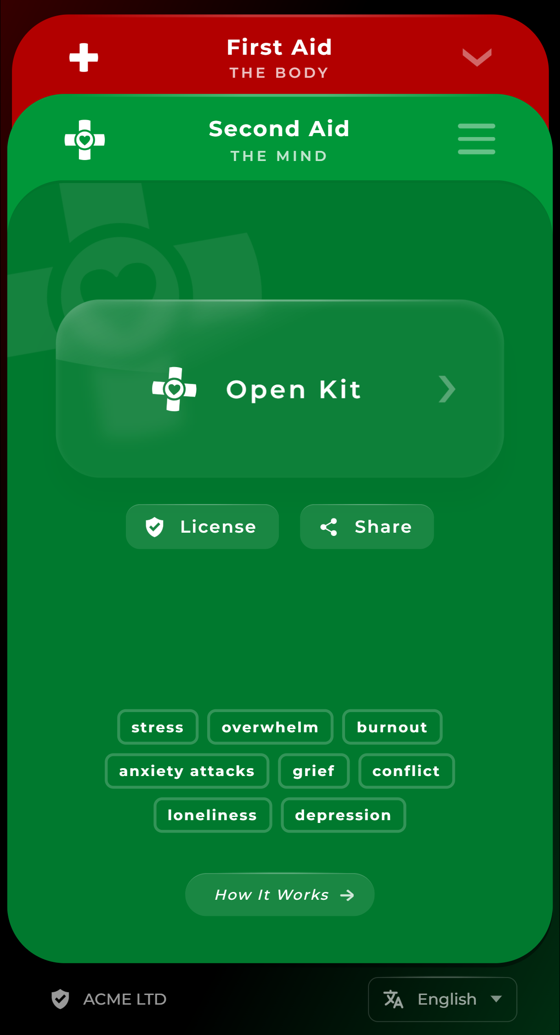
Professionally licensed.
Your organization name, visible.
Licensed
Second Aid

Slide 6
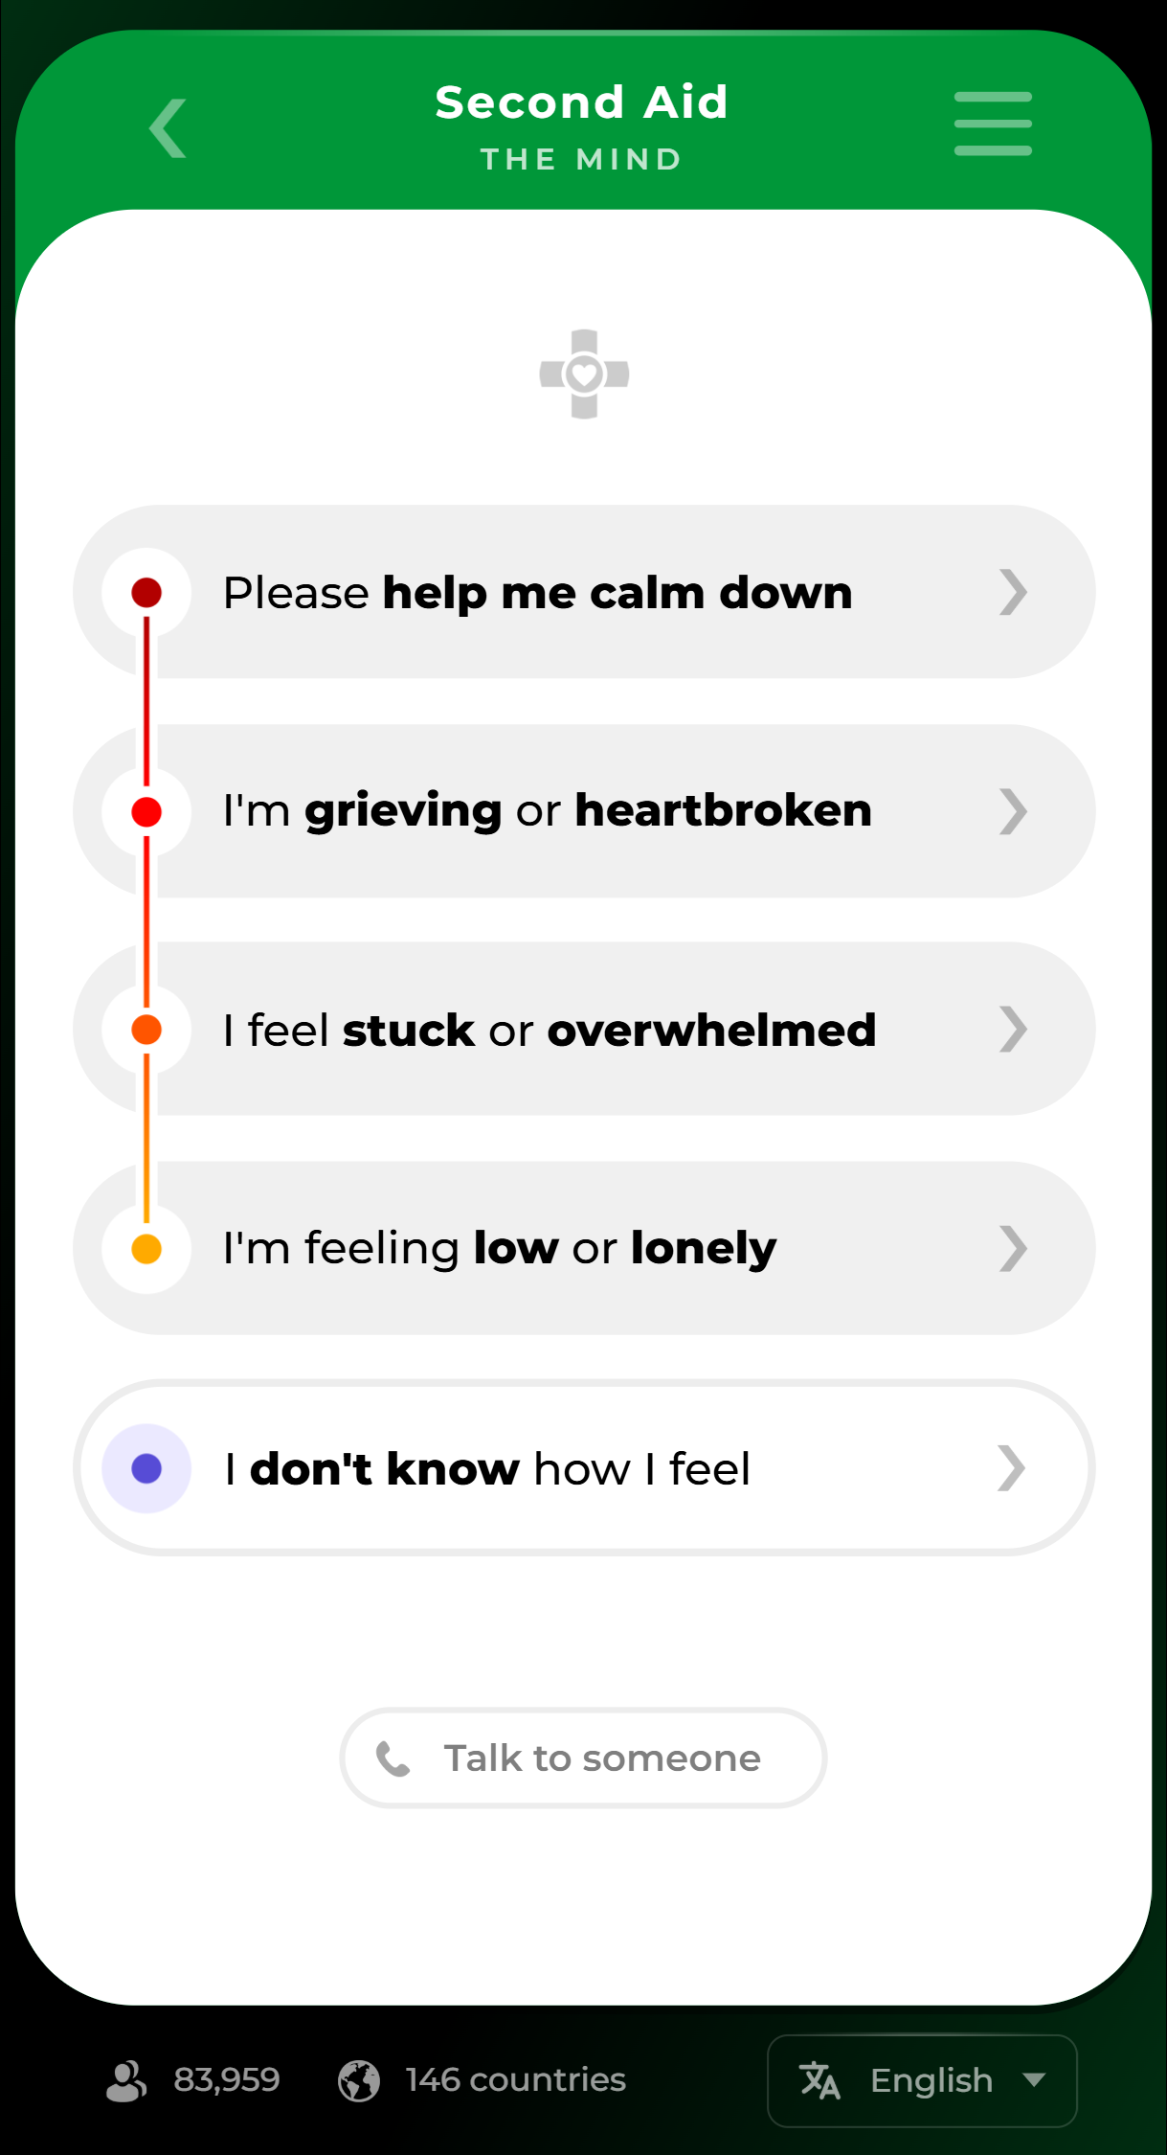
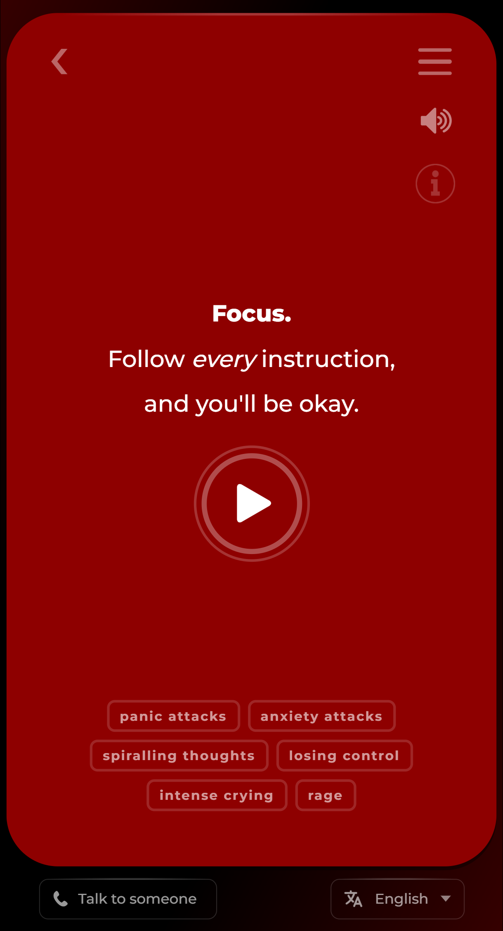
Simple and private.
No accounts.
No cookies.
100% private.
More info: secondaid.com/safety
What is
Second Aid?

Slide 7
The Mission
Have Second Aid next to every First Aid kit in every building across the globe.
Mental healthcare needs to be equal to physical healthcare to become normal.
Mission of
Second Aid

Slide 8
Learning from the past.
Before First Aid | Without Second Aid
Bleeding wound | Extreme distress
Contamination | Rumination
Infection | Sleep disruption
Disease escalation | Anxiety escalation
Critical condition | Critical condition
Late professional support | Late professional support
Long recovery or Fatal | Long recovery or Fatal
The impact
is proven.
USE KIT HERE
TO PREVENT
ESCALATION
For the full whitepaper: secondaid.com/whitepaper.pdf
Impact of
Second Aid

Slide 9

For everyone.
English | “First Aid” | “Second Aid” | secondaid.com
Spanish | “Primeros Auxilios” | “Segundos Auxilios” | segundosauxilios.com
French | “Premiers Secours” | “Deuxièmes Secours” | deuxiemessecours.com
German | “Erste Hilfe” | “Zweite Hilfe” | zweitehilfe.com
Italian | “Primo Soccorso” | “Secondo Soccorso” | secondosoccorso.com
Dutch | “Eerste Hulp” | “Tweede Hulp” | nl.secondaid.com
Portuguese | “Primeiros Socorros” | “Segundos Socorros” | pt.secondaid.com
Norwegian | “Førstehjelp” | “Andre Hjelp” | andrehjelp.com
Swedish | “Första hjälpen” | “Andra Hjälpen” | andrahjalpen.com
… | … | … | …
PHYSICAL HEALTH
MENTAL HEALTH
An impact
with global reach.
Available in 10+ languages
Vision of
Second Aid

Slide 10


1
2
3
Buy your
Second Aid
license at:
Use discount code for up to 30% off
You will instantly
receive your licensed kit.
secondaid.com
c123456
With our Education & Healthcare Subsidy, all schools, colleges, universities and hospitals get up to 40% off instead, both public & private institutions.
Licensing
Second Aid

Slide 11
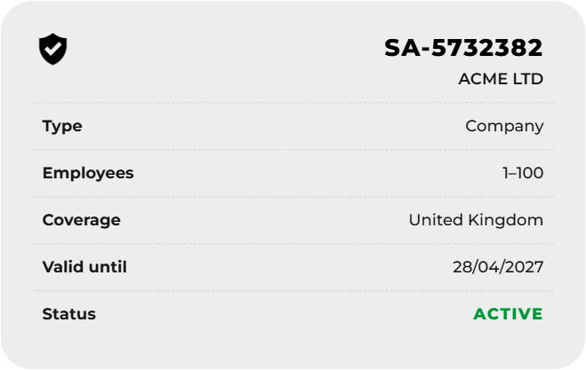


The kit.
What’s in
the kit?
Custom
QR Code
2
secondaid.com/?sa=1234567
Your
Official
License
1
3
Immediately available
after purchase.
Custom Link
Licensed Kit
Second Aid

Slide 12
First Aid, Body. Second Aid, Mind.
Your license awaits.
Use discount code for up to 30% off
www.secondaid.com
c123456
Second Aid
secondaid.com

